Slide 1

PROJECT NO. 1
PROJECT TITLE:
“ TO MINIMISE TURN AROUND TIME (TAT) OF RESOLVING CUSTOMER QUERIES
BY
REDUCING PROCESS TAT-DPMO ”
Proprietary and Highly Confidential. 2020 Pursullence Global Business Solutions. All Rights Reserved

Slide 2
DEFINE PHASE
Proprietary and Highly Confidential. 2020 Pursullence Global Business Solutions. All Rights Reserved

Slide 3
Identification of VOC and I-E Customers
Parameters | Identified Area
Voice of Customer | “There is high percentage of non-compliance of TAT by your service when compared to SLA agreement. Due to high non compliance I am loosing a lot of my customers and we will discontinue this agreement if the percentage non compliance is not reduced down as per requirement in SLA.”
External Customer | Mr. John and his Customers
Internal Customer | Mr. Venkat
Critical to Quality | Compliance with TAT for the process
Proprietary and Highly Confidential. 2020 Pursullence Global Business Solutions. All Rights Reserved

Slide 4
DATA COLLECTION PLAN

Slide 5
PROJECT CHARTER

Slide 6
Business Case
Project Scope
In-scope: This project is applicable to service of process 1 of account 1
Out Scope: This process is inapplicable to any other accounts and process
Mr. Venkat is the client relationship manager and process owner at Silverline Services. The client Mr. John is their big client and he reported to Mr. Venkat “There is high percentage of non-compliance of TAT by your service when compared to SLA agreement. Due to high non compliance I am loosing a lot of my customers and we will discontinue this agreement if the percentage non compliance is not reduced down as per requirement in SLA.” To save the big client Mr. Venkat has to work on reducing the TAT time of the process that provides service to Mr. John
QNS
In money
Client retention rate will increase
Team Members
Role | Name | Org.
Black Belt/ Manager | Mr. Sanket Nair | Silverline Services
MBB/mentor/Sr. Manager | Mr. Rajendra Rao | Silverline Services
GB | Mr. Sandeep Singh | Silverline Services
Core Team | Mr. Sujay More, Mr. Sudeep Mane | Silverline Services
Process Owner/ Champion | Mr. Venkat | Silverline Services
SME | Mr. Ajay Lal | Silverline Services
Finance | Ms. Ayesha Dhawan | Silverline Services
Problem Statement
Out of 92 days of historical data collection, avg. TAT per day for 47 days is higher than allowed TAT of 180 min. It means that process has not met the TAT target for almost 49% of the days, which is severe !
Project Timeline
Goal Statement
Phase | Start Date | End Date
Define | 15th February 2020 | 27th February 2020
Measure | 1st March 2020 | 30th March 2020
Analyze | 1st April 2020 | 10th April 2020
Improve | 11th April 2020 | 15th May 2020
Control | 16th May 2020 | 30th June 2020
To improve customer query resolution time by reducing process TAT - DPMO from xxxxx to yyyyyy by Jun'20.
Proprietary and Highly Confidential. 2020 Pursullence Global Business Solutions. All Rights Reserved

Slide 7
SIPOC
SUPPLIER
INPUT
PROCESS
OUTPUT
CUSTOMER
Infrastructure based help desk ticketing tool
SLA agreement
Laptop
Process Individuals
Complaint raised by customers.
The executive raises the ticket.
The executive resolves the tickets.
If the issue is not solved pass it to manager and a new ticket is raised.
The ticket is resolved and updated as ticket resolved in the log
Give a follow up to the customer
Close the ticket
Resolved Ticket
Customer seeking service
Proprietary and Highly Confidential. 2020 Pursullence Global Business Solutions. All Rights Reserved

Slide 8
Process Map:
Quality - Help Desk Process Map

Slide 9
RACI MATRIX
RACI | RESPONSIBLE PERSON | NAME OF PERSON
Responsible | Green Belt | Mr. Sandeep Singh
Approval | Manager | Mr. Sanket Nair
Consult | Sr. Manager | Mr. Rajendra Rao
Inform | Process Owner/MBB | Mr. Rajendra & Mr. Venkat
Review | RESPONSIBLE PERSON | NAME OF PERSON
Weekly | Responsible, Approval | Mr. Sandeep Singh & Mr. Sanket Nair
Fortnightly | Responsible, Approval & Consult | Mr. Sandeep Singh, Mr. Sanket Nair & Mr. Rajendra Rao
Monthly/Tollgate | Responsible, Approval, Consult & Inform | Mr. Sandeep Singh, Mr. Sanket Nair, Mr. Rajendra Rao, Mr. Rajendra & Mr. Venkat

Slide 10
MEASURE PHASE

Slide 11
Performance Standards
Unit Of Measure (UOM)
Every Single Day When Tickets Received By Compliance Resolution Team
Opportunity
Every Single Day When Tickets Received By Compliance Resolution Team
Data Source
System/(Helpdesk Ticketing Tool)
Operational Definition
Number Of Days When Avg. TAT Per Day Is
> Planned TAT i.e. 180 min
Specification Limits & Target Value
USL – 180 min ; Target-180 min; LSL – NA
Data (Y) - Discrete
Defective Definition
Any Day With Avg. TAT of > 180 min.
Defect Definition
Any Ticket With TAT > 180 min.
Proprietary and Highly Confidential. 2020 Pursullence Global Business Solutions. All Rights Reserved

Slide 12
MEASUREMENT SYSTEM ANALYSIS
As Data Is Collected From System Generated Helpdesk Ticketing Tool, So There Is No Need To Perform MSA
Proprietary and Highly Confidential. 2020 Pursullence Global Business Solutions. All Rights Reserved

Slide 13
List of Potential Causes
SR NO | CAUSES
1 | Shifts
2 | Unplanned call fluctuations
3 | Employee
4 | Educational background
5 | Gender
6 | Experience
7 | Calls Take Longer Than Expected
8 | Long after call work (wrap-up) time
9 | Server down issues
10 | Lack of knowledge to resolve
11 | Lack of confidence
12 | TL
SR NO | CAUSES
13 | % Of Rework Incidences In Given Day (% Of Total Rework Incidences / Total Requests Processed)
14 | Unscheduled meeting on given day
15 | % Unplanned leaves on given day
16 | Day of week
17 | Types of task complexity
18 | Lack of training
19 | Wrong procedure followed
20 | Sop not done
21 | Manuals not updated
22 | Technical System issue
23 | Unwillingness to work
Proprietary and Highly Confidential. 2020 Pursullence Global Business Solutions. All Rights Reserved

Slide 14
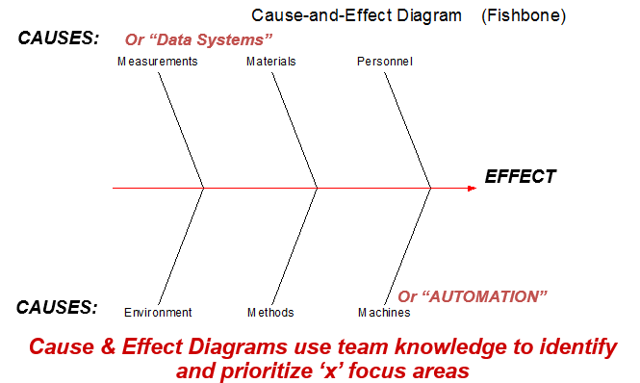
Ishikawa / Fishbone/ Cause & Effect Diagram
Types of task complexity
Lack of confidence
Employee
Day of week
Lack of knowledge to resolve
Unscheduled meeting on given day
Educational background
% Of Rework
Incidences
Unwillingness to work
% Unplanned leaves on given day
Lack of knowledge to
resolve
Experience/Tenure
TL
TAT
Compliance (Y)
Technical System issue
Lack of training
Manuals
not updated
Server down issues
Long after call
work (wrap-up) time
Shifts
Calls Taken Longer
Than Expected
Wrong procedure
followed
SOP not done
Proprietary and Highly Confidential. 2020 Pursullence Global Business Solutions. All Rights Reserved

Slide 15
C-I MATRIX
SR NO | CAUSES | TYPE
 |  | CONTROLLABLE/ NON CONTROLLABLE | HIGH/LOW IMPACTABLE | MEASUREABLE/NON-MEASUREABLE
1 | Shifts | CONTROLLABLE | HIGH IMPACTABLE | MEASUREABLE
2 | Unplanned call fluctuations | NON CONTROLLABLE | LOW IMPACTABLE | MEASUREABLE
3 | Employee | CONTROLLABLE | HIGH IMPACTABLE | MEASUREABLE
4 | Educational background | CONTROLLABLE | HIGH IMPACTABLE | MEASUREABLE
5 | Gender | CONTROLLABLE | HIGH IMPACTABLE | MEASUREABLE
6 | Experience | CONTROLLABLE | HIGH IMPACTABLE | MEASUREABLE
7 | Calls Take Longer Than Expected | NON CONTROLLABLE | LOW IMPACTABLE | NON-MEASUREABLE
8 | Long after call work (wrap-up) time | CONTROLLABLE | LOW IMPACTABLE | NON-MEASUREABLE
9 | Server down issues | NON CONTROLLABLE | LOW IMPACTABLE | NON-MEASUREABLE
10 | Lack of knowledge to resolve | NON CONTROLLABLE | LOW IMPACTABLE | NON-MEASUREABLE
11 | Lack of confidence | NON CONTROLLABLE | HIGH IMPACTABLE | NON-MEASUREABLE
12 | TL | CONTROLLABLE | HIGH IMPACTABLE | MEASUREABLE
Proprietary and Highly Confidential. 2020 Pursullence Global Business Solutions. All Rights Reserved

Slide 16
C-I MATRIX
SR NO | CAUSES | TYPE
 |  | CONTROLLABLE/ NON CONTROLLABLE | HIGH/LOW IMPACTABLE | MEASUREABLE/NON-MEASUREABLE
13 | % Of Rework Incidences In Given Day (% Of Total Rework Incidences / Total Requests Processed) | CONTROLLABLE | HIGH IMPACTABLE | MEASUREABLE
14 | Unscheduled meeting on given day | NON CONTROLLABLE | LOW IMPACTABLE | NON-MEASUREABLE
15 | % Unplanned leaves on given day | CONTROLLABLE | HIGH IMPACTABLE | MEASUREABLE
16 | Day of week | CONTROLLABLE | HIGH IMPACTABLE | MEASUREABLE
17 | Types of task complexity | CONTROLLABLE | HIGH IMPACTABLE | MEASUREABLE
18 | Lack of training | CONTROLLABLE | HIGH IMPACTABLE | NON-MEASUREABLE
19 | Wrong procedure followed | NON CONTROLLABLE | LOW IMPACTABLE | NON-MEASUREABLE
20 | Sop not done | CONTROLLABLE | HIGH IMPACTABLE | NON-MEASUREABLE
21 | Manuals not updated | CONTROLLABLE | LOW IMPACTABLE | NON-MEASUREABLE
22 | Technical System issue | NON CONTROLLABLE | HIGH IMPACTABLE | NON-MEASUREABLE
23 | Unwillingness to work | CONTROLLABLE | LOW IMPACTABLE | NON-MEASUREABLE
Proprietary and Highly Confidential. 2020 Pursullence Global Business Solutions. All Rights Reserved

Slide 17
SAMPLING PLAN
Types of Sampling used :-
Random Sampling
In random sampling each sample has equal probability of chosen from population.
Stratified Sampling
It is a powerful sampling technique that allows sampled data to be separated into ‘subgroups’ called “strata”
Proprietary and Highly Confidential. 2020 Pursullence Global Business Solutions. All Rights Reserved

Slide 18
Data Collection Plan
CONTROLLABLE / NON CONTROLLABLE |  |  | OPERATIONAL DEFINATION | SAMPLING PLAN
What to measure | Y or X | Data Type | OPERATIONAL DEFINATION | What | Where | When | How many
TAT COMPLIANCE PER DAY | X | Discrete | TAT Compliance per day is MET if avg TAT of a given day is equal or less than planned TAT of 180min. | Collect database for Non compliance tickets as per SLA | Ticketing Tool | 02/03/2020 | Minimum
Gender | X | Discrete | Which Gender |  | Excel database | to | 20 samples
Experience/Tenure | X | Discrete | Which Tenure level |  |  | 27/03/2020
TL | X | Discrete | Which TL (name wise)
Day of week | X | Discrete | For Which day( Monday- Friday)
Shifts of Day | X | Discrete | For Which Shift (Morning, Afternoon, Night)
Educational background (G/PG) | X | Discrete | Educational background (G/PG)
Proprietary and Highly Confidential. 2020 Pursullence Global Business Solutions. All Rights Reserved

Slide 19
Data Collection Plan
CONTROLLABLE / NON CONTROLLABLE |  |  | OPERATIONAL DEFINATION | SAMPLING PLAN
What to measure | Y or X | Data Type | OPERATIONAL DEFINATION | What | Where | When | How many
% Of Rework Incidences In Given Day | X | Continuous/Discrete | % Rework incidences per day | Collect database for Non compliance tickets as per SLA | Ticketing Tool | 02/03/2020 | Minimum
% Unplanned leaves on given day | X | Continuous | % Unplanned leaves per day |  | Excel database | to | 20 samples
Employee | X | Discrete | Name of employees |  |  | 27/03/2020
Average handling Tasks per day by each employee | X | Continuous | Average handling Tasks per day by each employee
Unscheduled meeting on given day (in min) | X | Continuous | No of Unscheduled meeting
Proprietary and Highly Confidential. 2020 Pursullence Global Business Solutions. All Rights Reserved

Slide 20
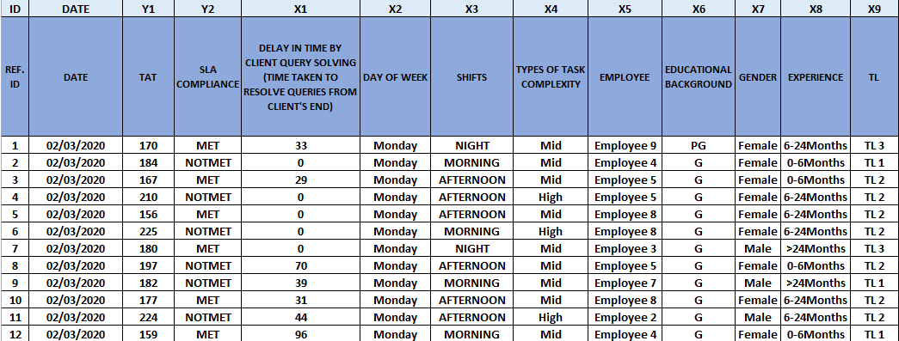
Data Collection In Excel Format
Proprietary and Highly Confidential. 2020 Pursullence Global Business Solutions. All Rights Reserved

Slide 21
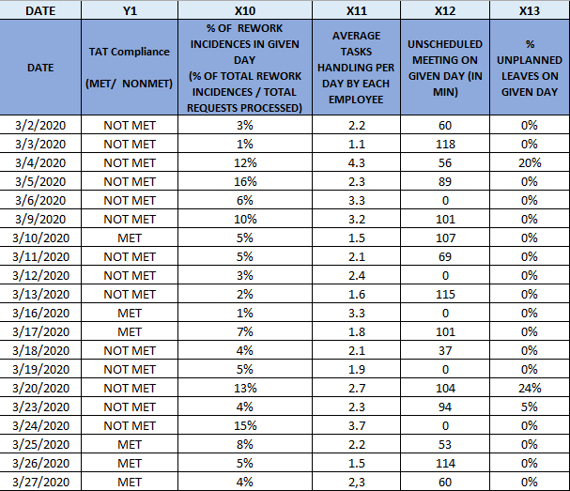
Data Collection In Excel Format
Proprietary and Highly Confidential. 2020 Pursullence Global Business Solutions. All Rights Reserved

Slide 22
CAPABILITY ANALYSIS-SIGMA VALUE CALCULATION
For Continuous Data: For Discrete Data:
FORMULA
FORMULA
LONG TERM SIGMA VALUE =
LONG TERM SIGMA VALUE =
NORMSINV(1-DPO)
NORMSINV(1-DPO)
SHORT TERM SIGMA VALUE =
LONG TERM VALUE + 1.5
Note: if the spec limit is an UPPER spec, the numerator is USL – Mean (or Target);
if the spec limit is a LOWER spec, the numerator is Mean (or Target) - LSL
Proprietary and Highly Confidential. 2019 Pursullence Global Business Solutions. All Rights Reserved

Slide 23
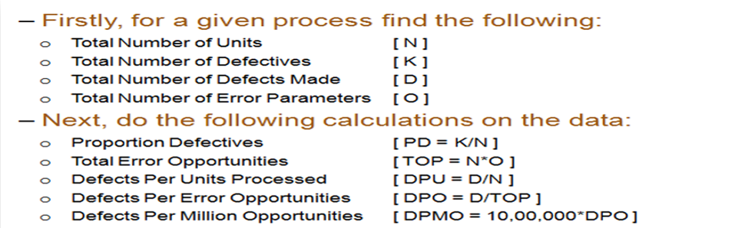
DETERMINE PROCESS CAPABILITY- DPMO
DPMO – Defects per million opportunities
For Sigma Value use Excel formula:
LONG TERM SIGMA VALUE (ZLT) | ZLT= normsinv( 1- DPO)

Slide 24
CAPABILITY ANALYSIS
DEFECTIVE DEFINITION | Avg. TAT per day >180
TOTAL UNITS | 20
TOTAL OPPORTUNITIES | 20
DEFECTIVE | 14
DEFECTS/DEFECTIVES PER OPPORTUNITIES | 0.7
DEFECTIVES PER MILLION OPPORTUNITIES | 7,00,000
LONG TERM SIGMA VALUE (ZLT) normsinv( 1- DPO) i.e ( 1-0.7) | - 0.524
SHORT TERM SIGMA VALUE (ZST) (N/A) | NA

Slide 25
ANALYZE PHASE

Slide 26
GRAPHICAL ANALYSIS
Proprietary and Highly Confidential. 2020 Pursullence Global Business Solutions. All Rights Reserved

Slide 27
INFERENTIAL TEST
Proprietary and Highly Confidential. 2020 Pursullence Global Business Solutions. All Rights Reserved

Slide 28
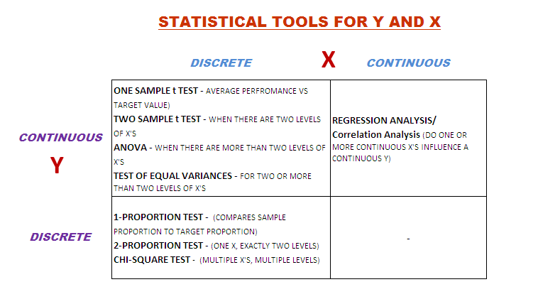
Statistical Tools Selection– Quick Reference
Proprietary and Highly Confidential. 2020 Pursullence Global Business Solutions. All Rights Reserved

Slide 29
IMPROVE PHASE
Proprietary and Highly Confidential. 2020 Pursullence Global Business Solutions. All Rights Reserved

Slide 30
Solution Brainstorming
Significant X’s | Solutions 1 | Solutions 2 | Solutions 3 | Solutions 4
1. Shifts | Night shift TL should ensure monitoring dailiy performance of bottom 20% performers. | develop personal performance tracker for bottom 20% performers.
2. Type of task complexity | analyse past 3 months task distribution and increase high complex task distribution to experienced memebers by 20-30% over next3 weeks.
3. Employee Experience /Tenure | Arrange a meeting with mid experienced staff and discuss their challenges and best practices with them and incorporate adequeate best practices. | arrange refresh training sessions for mid experienced professionals. | Develop and improvement plan for consistent low performers | Standardise technicians / engineers performance with frequent online tests every week that ensure employee know details of the process and error patterns. And map their performance with appraisals.
4. % Rework Incidence in given day | Analyse rework incidences over last 3 months and segregrate frequent rework type and understand its pattern timewise, employeewise and accordingly plan a solution. | understand best practices shared by experienced employees and ensure a gap between exp vs freshers reduces. | monetary motivations should be considered | Timely calibration studies to standardise performers of quality team
5. Avg. Tasks handling per day | conduct a task handling assessment for next 3-4 days with few case staff from exp/mid exp/freshers and understand time consumption patterns across volume driven (actual tasks), trigger driven(meetings driven) and % time consumptions on work on total time spent in office. | ensure task switching reduces by 20-30% at freshers level by ensuring minimal task switching for freshers as low as 1 task a day.
6. % Unplanned leaves | analyse unplanned leaves pattern restructure appraisal policy with negative points on unplanned leaves. | encourage team planned leaves before time.
Proprietary and Highly Confidential. 2020 Pursullence Global Business Solutions. All Rights Reserved

Slide 31
Solution Refining
Significant X’s | Ideas | Impact | Low Cost | Feasible to Deploy | Authority Consent | Solutions Priority Index
1. Shifts | Night shift TL should ensure monitoring daily performance of bottom 20% performers. | 3 | 3 | 3 | 3 | 81
 | Develop personal performance tracker for bottom 20% performers. | 3 | 3 | 3 | 3 | 81
2. Type of task complexity | Analyze past 3 months task distribution and increase high complex task distribution to experienced members by 20-30% over next3 weeks. | 3 | 3 | 3 | 3 | 81
3. Employee Experience /Tenure | Arrange a meeting with mid experienced staff and discuss their challenges and best practices with them and incorporate adequate best practices. | 3 | 3 | 3 | 3 | 81
 | Arrange refresh training sessions for mid experienced professionals. | 3 | 2 | 3 | 2 | 36
 | Develop an improvement plan for consistent low performers | 3 | 3 | 2 | 3 | 54
 | Standardize technicians / engineers performance with frequent online tests every week that ensure employee know details of the process and error patterns. And map their performance with appraisals. | 3 | 2 | 2 | 3 | 36
4. % Rework Incidence in given day | Analyse rework incidences over last 3 months and segregrate frequent rework type and understand its pattern timewise, employeewise and accordingly plan a solution. | 3 | 3 | 3 | 3 | 81
 | Understand best practices shared by experienced employees and ensure a gap between exp vs. freshers reduces. | 3 | 3 | 2 | 3 | 54
 | Monetary motivations should be considered | 3 | 1 | 3 | 2 | 18
 | Timely calibration studies to standardise performers of quality team | 3 | 2 | 2 | 3 | 36
5. Avg. Tasks handling per day | Conduct a task handling assessment for next 3-4 days with few trial case staff from exp/mid exp / freshers and understand time consumption patterns across volume driven (actual tasks), trigger driven(meetings driven) and % time consumptions on work on total time spent in office. | 3 | 2 | 3 | 3 | 54
 | Ensure task switching reduces by 20-30% at freshers level by ensuring minimal task switching for freshers as low as 1 task a day. | 3 | 3 | 3 | 3 | 81
6. % Unplanned leaves | Analyse unplanned leaves pattern restructure appraisal policy with negative points on unplanned leaves. | 3 | 3 | 3 | 3 | 81
 | Encourage team planned leaves before time. | 3 | 3 | 3 | 3 | 81
Proprietary and Highly Confidential. 2020 Pursullence Global Business Solutions. All Rights Reserved

Slide 32
Pilot Phase Planning and Data Collection
PHASE I : SOLUTIONS SENSITIZATION ( 1st April 2020 to 10th April 2020)
From process 1 of Account 1 of Silver line Services, bottom 10% resources are planned to analyze based on historical data. Pilot project will be implemented upon bottom 10% performers from each experience tenure level.
Project problem will be discussed with them, important causes and probable solutions need to be communicated to them in a small session. Probable challenges to implement solutions will be discussed and 10 days timeline from 1st April 2020 to 10th April 2020 will be allocated for solutions sensitization.
Process TL will track the challenges to deploy solutions and best practices sharing on daily basis.
LSSGB project leader and AM will review solution implementation status on alternate days and ensure smooth implementation of solutions and will provide adequate support.
PHASE II : ASSESSMENT OF SOLUTION STANDARDIZATION : ( 11th April 2020 to 12th April 2020)
1. On 11th April 2020, a small test will be conducted among pilot participants to assess their understanding of new changes or solutions. If test will assure that > 90% participants’ scores are satisfactory, then we will confirm that solution standardization is accomplished. Update will be communicated to authorities/process owner.
PHASE III : IMPROVE PHASE DATA COLLECTION AND IMPROVEMENT VALIDATION : (13th April, 2020 until 17th May 2020 )
Improve phase data collection will commence from Monday, 13th April, 2020 until 17th May 2020. If Improvement will be achieved, it will be validated based on adequate statistical tests and capability analysis. Results will be shared with authorities and improvement will be assessed monetarily.
Proprietary and Highly Confidential. 2020 Pursullence Global Business Solutions. All Rights Reserved

Slide 33
Data Collection
ID | DATE | Y1 | X3 | X4 | X8
REF. ID | DATE | TAT | SHIFTS | TYPES OF TASK COMPLEXITY | EXPERIENCE
1 | 14/04/2020 | 197 | NIGHT | Mid | 6-24Months
2 | 14/04/2020 | 156 | NIGHT | Mid | 6-24Months
3 | 14/04/2020 | 187 | MORNING | Mid | 0-6Months
4 | 14/04/2020 | 162 | AFTERNOON | Mid | 0-6Months
5 | 14/04/2020 | 178 | AFTERNOON | High | 6-24Months
6 | 14/04/2020 | 188 | AFTERNOON | Mid | 6-24Months
7 | 14/04/2020 | 162 | MORNING | High | 6-24Months
8 | 14/04/2020 | 167 | NIGHT | Mid | >24Months
9 | 14/04/2020 | 186 | AFTERNOON | Mid | 0-6Months
10 | 14/04/2020 | 181 | MORNING | Mid | >24Months
11 | 14/04/2020 | 216 | AFTERNOON | Mid | 6-24Months
12 | 14/04/2020 | 153 | AFTERNOON | High | 6-24Months
13 | 14/04/2020 | 164 | MORNING | Mid | 0-6Months
14 | 14/04/2020 | 179 | NIGHT | High | 0-6Months
15 | 14/04/2020 | 203 | NIGHT | Mid | >24Months
16 | 14/04/2020 | 166 | NIGHT | Mid | 0-6Months
17 | 14/04/2020 | 176 | MORNING | Mid | 0-6Months
18 | 14/04/2020 | 208 | MORNING | Mid | >24Months
19 | 14/04/2020 | 162 | AFTERNOON | Mid | 6-24Months
20 | 14/04/2020 | 214 | NIGHT | High | 6-24Months
21 | 14/04/2020 | 195 | AFTERNOON | Mid | 6-24Months
22 | 14/04/2020 | 219 | NIGHT | High | 6-24Months
23 | 14/04/2020 | 215 | AFTERNOON | Mid | 0-6Months
24 | 14/04/2020 | 158 | MORNING | Mid | >24Months
25 | 14/04/2020 | 209 | NIGHT | Mid | >24Months
Proprietary and Highly Confidential. 2020 Pursullence Global Business Solutions. All Rights Reserved

Slide 34
Stability Analysis using Run Chart
Purpose: To check whether Improve phase data is stable or not. (For Continuous Y - % TAT Compliance)
Minitab Session Window output:
Minitab Path: Stat> Control Control> Run Chart
Interpretation: Since p-value for all Clustering, Mixtures, Trends & Oscillations are greater than 0.05, therefore, Data is stable.
Proprietary and Highly Confidential. 2020 Pursullence Global Business Solutions. All Rights Reserved

Slide 35
Normality Analysis
Purpose: To check the Normality of % TAT Compliance of improve phase (For Continuous Y - % TAT Compliance)
Minitab Session Window output:
Minitab Path: Stat> Basic Statistics> Normality Test
Interpretation: Since the p- value is less than alpha value 0.05, data does not follows Normality i.e. Data is non-normal.
Proprietary and Highly Confidential. 2020 Pursullence Global Business Solutions. All Rights Reserved

Slide 36
Validation Test – 2 Proportion Test
Purpose: To check whether the improvement is accomplished in improve phase.
Hypothesis:
H_{o} : The proportion of % TAT Compliance in Improve phase is same as the proportion of % TAT Compliance in Measure Phase (p₁ = p₂).
H_{a} : The proportion of % TAT Compliance in Improve phase is more than the proportion of % TAT Compliance in Measure Phase (p₁ < p₂).
Test and CI for Two Proportions
Sample X N Sample p
1 1 20 0.050000
2 20 25 0.800000
Difference = p (1) - p (2)
Estimate for difference: -0.7595
% Upper Bound for difference: -0.595918
Test for difference = 0 (vs > 0): Z = -8.01 P-Value = 0.000
Interpretation: Since the p- value is less than 0.05 (alpha value), so we reject Ho it suggest that the proportion of TAT Compliance in Improve phase is more than the proportion of TAT Compliance in Measure Phase.
Conclusion: Since the p- value is less than 0.05 (alpha value), Hence improvement in % TAT Compliance is accomplished for total population.
Proprietary and Highly Confidential. 2019 Pursullence Global Business Solutions. All Rights Reserved

Slide 37
Validation Test – 1 Proportion Test
Purpose: To validate whether the defined Goal is met and applicable for total population in improve phase.
Hypothesis:
H_{o} : The proportion of TAT Compliance in improve phase is same as the target proportion (p = p_{o} )
v/s
H_{a} : The proportion of TAT Compliance in improve phase is less than the target proportion (p < p_{o})
Test and CI for One Proportion
Test of p = 0.46 vs p < 0.46
Sample X N Sample p 95% Lower Bound P-Value
1 20 25 0.800000 0.917709 1.000
Interpretation: Since the p- value is greater than 0.05 (alpha value), we fail to reject Ho, hence the proportion of TAT Compliance in improve phase is same as the target proportion.
Conclusion: Since p- value is > of 0.05 (alpha value), we can conclude that % TAT compliance is achieved set target (i.e, 46%). Hence we can infer that improvement goal is accomplished in improve phase.
Proprietary and Highly Confidential. 2019 Pursullence Global Business Solutions. All Rights Reserved

Slide 38
Capability Test
Summary Table:
DEFECTIVE DEFINITION | % TAT Compliance <43%
TOTAL UNITS | 25
TOTAL OPPORTUNITIES | 25
DEFECTIVE | 2
DEFECTS/DEFECTIVES PER OPPORTUNITIES | 0.08
DEFECTIVES PER MILLION OPPORTUNITIES | 80,000
LONG TERM SIGMA VALUE (ZLT) normsinv( 1- DPO) i.e ( 1-0.08) | 1.41
SHORT TERM SIGMA VALUE (ZST) ZST = ZLT + 1.5 | NA
Since data is non-normal, we used long term sigma value. There are 2 data points less than 8% out of 25 opportunities. Long term sigma value is 1.41.
Proprietary and Highly Confidential. 2020 Pursullence Global Business Solutions. All Rights Reserved

Slide 39
Phase-wise Sigma Value Comparison
Summarized Graph:
Interpretation: If we observe the graph, the long term sigma value was -0.52 in Measure phase, it improved to 1.41 in improve phase so, there is a improvement observed in long term sigma value from measure phase to improve phase.
Proprietary and Highly Confidential. 2019 Pursullence Global Business Solutions. All Rights Reserved

Slide 40
Validation Test for X’s Improvement
Minitab Output of Correlation Test for Y and X
Minitab path : Stat>Basic Statistics>Correlation.
Correlation: % TAT Compliance, % OF REWORK INCIDENCES IN GIVEN DAY
Correlations
Pearson correlation - 0.435
P-value 0.030
Interpretation:
Impact of “% Rework Incidences per day” on % TAT compliance is statistically significant. In measure phase correlation coefficient r = -0.767. So after improvement, in improve phase, the correlation coefficient, ‘r’ = -0.435, indicates that as % rework incidences per day decreases, TAT increases moderately.
Proprietary and Highly Confidential. 2020 Pursullence Global Business Solutions. All Rights Reserved

Slide 41
Validation Test for X’s Improvement
Minitab Output of Test for Equal Variances Y and X:
Minitab Path: Stat>ANOVA>Test for Equal Variances…
Test for Equal Variances: TAT versus SHIFTS
Method
Null hypothesis All variances are equal
Alternative hypothesis At least one variance is different
Significance level α = 0.05
Bartlett’s method is used. This method is accurate for normal data only.
95% Bonferroni Confidence Intervals for Standard Deviations
SHIFTS N Std. Dev CI
AFTERNOON 560 20.0186 (18.6770, 21.5557)
MORNING 484 20.3785 (18.9164, 22.0711)
NIGHT 456 19.1514 (17.7387, 20.7942)
Individual confidence level = 98.3333%
Tests
Test
Method Statistic P-Value
Bartlett 1.89 0.388
Interpretation: Here p-value is > 0.05, we fail to reject null hypothesis. Hence, Impact of “Shift of Day” On TAT Is by random chance. So after improvement, there is no impact of shift of day on TAT.
Proprietary and Highly Confidential. 2020 Pursullence Global Business Solutions. All Rights Reserved

Slide 42
Validation Test for X’s Improvement
Variance test is failed so we go for mean testing
Minitab Path: Stat-ANOVA-One-Way…
One-way ANOVA: TAT versus SHIFTS
Method
Null hypothesis All means are equal
Alternative hypothesis At least one mean is different
Significance level α = 0.05
Analysis of Variance
Source DF Adj SS Adj MS F-Value P-Value
SHIFTS 2 1181 590.6 1.49 0.225
Error 1497 591481 395.1
Total 1499 592662
Model Summary
S R-sq R-sq(adj) R-sq(pred)
19.8774 0.20% 0.07% 0.00%
Means
SHIFTS N Mean Std.Dev 95% CI
AFTERNOON 560 179.115 20.019 (177.467, 180.763)
MORNING 484 179.007 20.378 (177.234, 180.779)
NIGHT 456 180.992 19.151 (179.166, 182.817)
Pooled Std.Dev = 19.8774
Minitab Output of Test for one way ANOVA Y and X:
Interpretation: Here p-value is > 0.05, we fail to reject null hypothesis. Hence, Impact of “Shift of Day” On TAT Is by random chance. So after improvement, there is no impact of shift of day on TAT.
Proprietary and Highly Confidential. 2020 Pursullence Global Business Solutions. All Rights Reserved

Slide 43
Validation Test for Improvement Summary
SR. NO. | Y | X | TEST | P-VALUE | INTERPRETATION
1 | TAT | TYPES OF TASK COMPLEXITY | EQUAL VARIANCE TEST | 0.526 | Since p-value is > 0.05, we fail to reject null hypothesis. Hence, Impact of “Types of Task Complexity” On TAT Is by random chance.
2 | TAT | EXPERIENCE | EQUAL VARIANCE TEST | 0.899 | Since p-value is > 0.05, we fail to reject null hypothesis. Hence, Impact of “Educational Background” On TAT Is by random chance.
3 | TAT | TYPES OF TASK COMPLEXITY | ONE WAY ANOVA | 0.747 | Since p-value is > 0.05, we fail to reject null hypothesis. Hence, Impact of “Types of Task Complexity” On TAT Is by random chance.
4 | TAT | EXPERIENCE | ONE WAY ANOVA | 0.758 | Since p-value is > 0.05, we fail to reject null hypothesis. Hence, Impact of “Educational Background” On TAT Is by random chance.
5 | % TAT COMPLIANCE | AVERAGE TASK HANDLING PER DAY | CORRELATION TEST | 0.231 | Since p-value is > 0.05, we fail to reject null hypothesis. Hence, Impact of “Average Tasks Handling Per Day By Employee” On % TAT Compliance Is by random chance.
6 | % TAT COMPLIANCE | % UNPLANNED LEAVES ON GIVEN DAY | CORRELATION TEST | 0.297 | Since p-value is > 0.05, we fail to reject null hypothesis. Hence, Impact of “% Unplanned Leaves Per Day” On % TAT Compliance Is by random chance.
Proprietary and Highly Confidential. 2020 Pursullence Global Business Solutions. All Rights Reserved

Slide 44
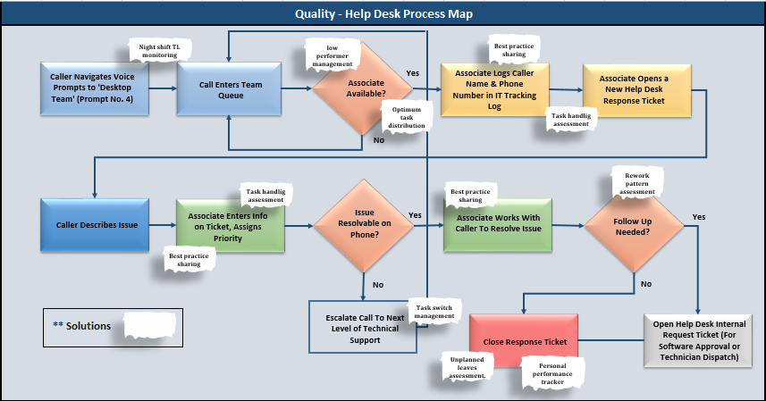
Updated Process Map

Slide 45
CONTROL PHASE
Proprietary and Highly Confidential. 2019 Pursullence Global Business Solutions. All Rights Reserved

Slide 46
FMEA
Proprietary and Highly Confidential. 2019 Pursullence Global Business Solutions. All Rights Reserved

Slide 47
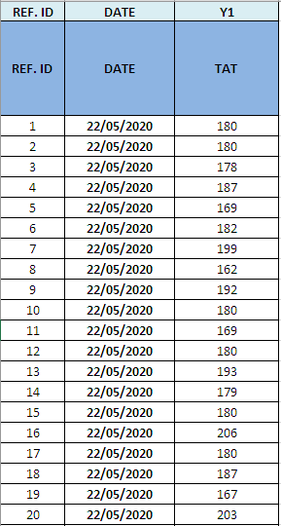
Data Collection for Control Phase
Proprietary and Highly Confidential. 2020 Pursullence Global Business Solutions. All Rights Reserved

Slide 48
Control Chart – Continuous data
: I-MR chart
From the Improve phase we have got 1 X (Cause), so we will draw a Control charts for the X and Y .
Y = % TAT Compliance
X10 = % of Rework Incidences In a Given Day
Proprietary and Highly Confidential. 2019 Pursullence Global Business Solutions. All Rights Reserved

Slide 49
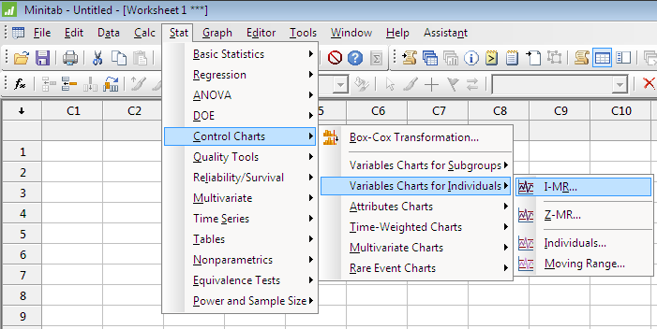
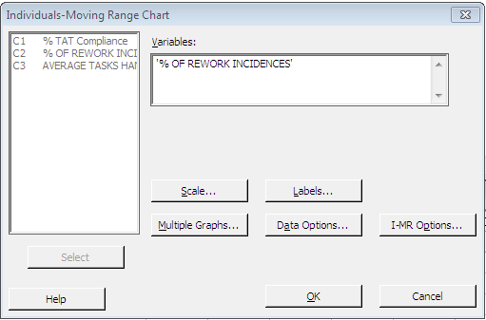
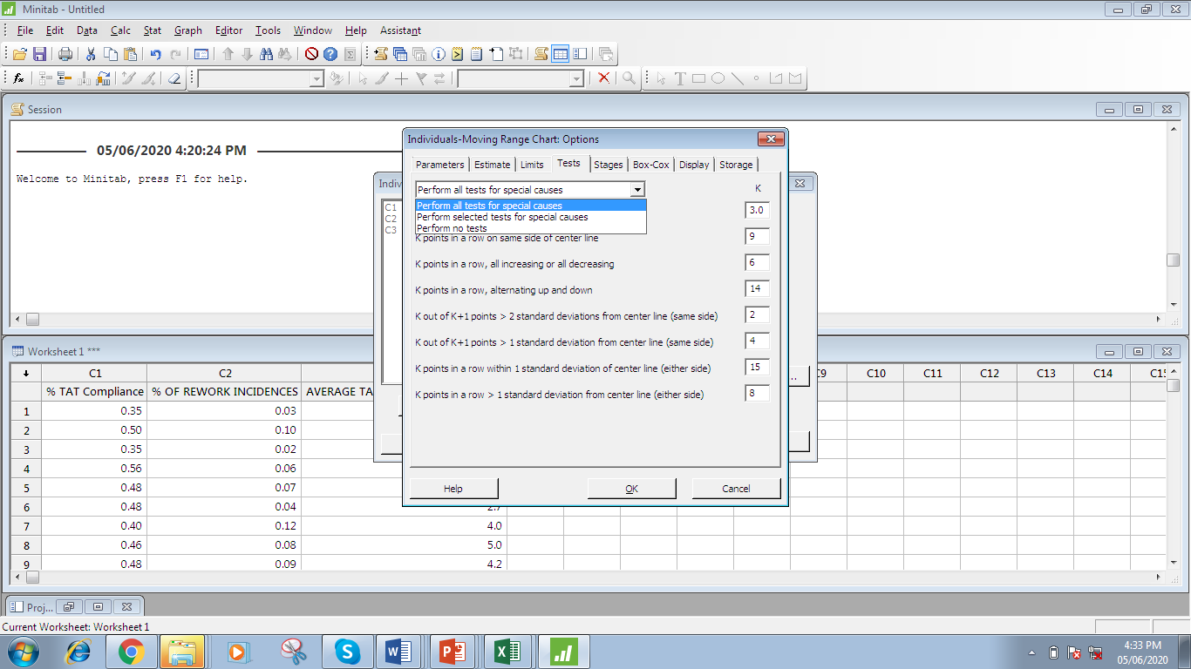
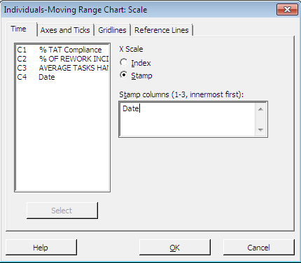
I-MR Chart
Minitab Path: Stat> Control Charts> Variables Charts for Individuals>I-MR . . .
1
For ‘Variables:’, select % of Rework Incidences
2
2.2
2.1
Select ‘I-MR Options . . .’
Click ‘OK’
Click on stamp & Select ‘Date’ as a X axis labels
Click ‘OK’
Click on the ‘Tests’ tab, then select ‘Perform all tests for special causes’
Click ‘OK’
Proprietary and Highly Confidential. 2019 Pursullence Global Business Solutions. All Rights Reserved

Slide 50
I-MR Chart
Minitab Session Window output:
% of Rework incidences for 40 days are tracked, as well as the differential between every 2 adjacent points (‘moving range’)
Interpretation
CONTROL limits (not specification limits!) are set at 3 standard deviations from the mean. Any data points beyond these limits are unusual and should be investigated.
In both the control charts almost every single data point lies between upper and lower control limit except one data point. Hence, we can conclude that significant cause (% Rework incidences) is stable and in control. Identified outlier was investigated, causes were found, solutions were discussed and implemented.
Proprietary and Highly Confidential. 2019 Pursullence Global Business Solutions. All Rights Reserved

Slide 51
I-MR Chart
Minitab Session Window output:
% TAT Compliance for 40 days are tracked, as well as the differential between every 2 adjacent points (‘moving range’)
Interpretation
CONTROL limits (not specification limits!) are set at 3 standard deviations from the mean. Any data points beyond these limits are unusual and should be investigated.
In both (Individual and Moving Range) the control charts all the data point falls within the control limits. Hence, % TAT Compliance is stable and in control.
Proprietary and Highly Confidential. 2019 Pursullence Global Business Solutions. All Rights Reserved

Slide 52
Stability Analysis
Purpose: To check whether the data is stable or not. (For Continuous Y - % TAT Compliance)
Minitab Session Window output:
Minitab Path: Stat> Control Control> Run Chart
Interpretation: Since p-value for all Clustering, Mixtures, Trends & Oscillations are greater than 0.05. Therefore, Data is stable.
Proprietary and Highly Confidential. 2019 Pursullence Global Business Solutions. All Rights Reserved

Slide 53
Normality Analysis
Purpose: To check the Normality of % TAT Compliance (For Continuous Y)
Minitab Session Window output:
Minitab Path: Stat> Basic Statistics> Normality Test
Interpretation: Since the p- value is less than alpha value 0.05, data does not follows Normality i.e. Data is non-normal.
Proprietary and Highly Confidential. 2019 Pursullence Global Business Solutions. All Rights Reserved

Slide 54
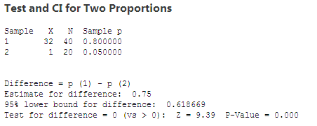
Validation Test – 2 Proportion Test
Purpose: To check whether the improvement is sustained in control phase.
Hypothesis
H_{o} : The proportion of % TAT Compliance in control phase is same as the proportion of TAT Compliance in Measure Phase (p₁ = p₂)
H_{a} : The proportion of % TAT Compliance in control phase is more than the proportion of TAT Compliance in Measure Phase (p₁ > p₂)
Interpretation: Since the p- value is less than 0.05 (alpha value), we reject null hypothesis and hence, the proportion of % TAT Compliance in control phase is more than the proportion of % TAT Compliance in Measure Phase.
Conclusion: Since the p- value is less than 0.05 (alpha value), we can conclude improvement in % TAT Compliance is sustained.
Proprietary and Highly Confidential. 2019 Pursullence Global Business Solutions. All Rights Reserved

Slide 55
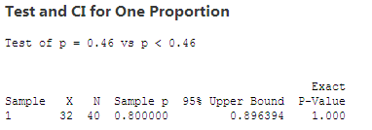
Validation Test – 1 Proportion Test
Purpose: To validate whether the defined Goal is met, sustained and whether the result is applicable for total population in control phase.
Hypothesis
H_{o} : The proportion of % TAT Compliance in control phase is same as the target proportion (p = p_{o})
H_{a} : The proportion of % TAT Compliance in control phase is less than the target proportion (p < p_{o})
Interpretation: Since the p- value is greater than 0.05 (alpha value), we fail to reject null hypothesis and hence, the proportion of % TAT Compliance in control phase is same as the target proportion.
Conclusion: Since p- value is greater 0.05 (alpha value), we can conclude that we have sustained with the target of 46% in control phase .
Proprietary and Highly Confidential. 2019 Pursullence Global Business Solutions. All Rights Reserved

Slide 56
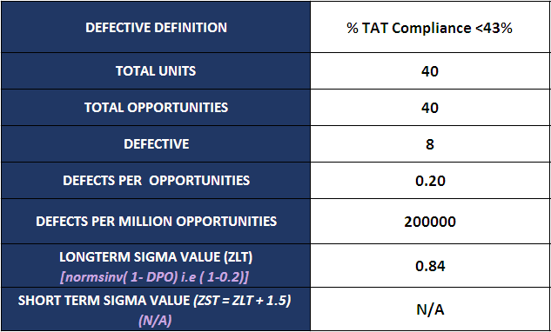
Capability Analysis
Summary Table
There are 8 data points less than 43% out of 40 opportunities. DPMO is 200000 and Long term sigma value is 0.84. Since data is non-normal short term sigma value is not applicable.
Proprietary and Highly Confidential. 2019 Pursullence Global Business Solutions. All Rights Reserved

Slide 57
Phase-wise Sigma Value Comparison
Summarized Graph
Interpretation: If we observe the graph, the long term sigma value was -0.52 in Measure phase, it improved to 1.41 in improve phase and get stable in control phase at 0.84. So, there is an improvement observed in long term sigma value from measure phase to control phase.
Proprietary and Highly Confidential. 2019 Pursullence Global Business Solutions. All Rights Reserved

Slide 58
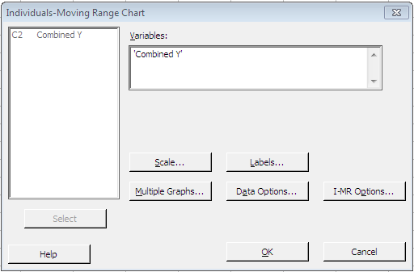
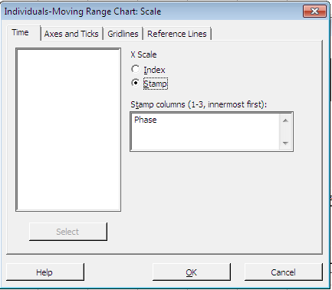
Individual Chart for Combined (Measure, Improve, Control) Performance of Y
Minitab Path: Stat> Control Charts> Variables Charts for Individuals>I-MR . . .
1
2
2.1
For ‘Variables:’, select Combined Y (% TAT Compliance)
Click on stamp & Select ‘Phase’ as a X-axis labels
Click ‘OK’
Click ‘OK’
Proprietary and Highly Confidential. 2019 Pursullence Global Business Solutions. All Rights Reserved

Slide 59
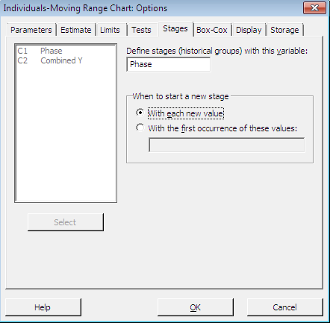
Individual Chart for Combined (Measure, Improve, Control) Performance of Y
2
Cont.…
2.2
2.3
Select ‘I-MR Options . . .’
Click ‘OK’
Click ‘OK’
Click ‘OK’
Click on the ‘Tests’ tab, then select ‘Perform all tests for special causes’
Click on Stages & In ‘Define Stages’ Select ‘Phase’ For Grouping and click on ‘With each new value’ option
Proprietary and Highly Confidential. 2019 Pursullence Global Business Solutions. All Rights Reserved

Slide 60
Combined Individual Chart for Performance of Y
Minitab Session Window output:
Interpretation: In measure phase, the process is unstable (i.e. out of statistical control). In improve phase the process comes into statistical control as Special Causes of variation are found. In control phase variation in the process is reduced through process improvement (control limits become narrower and process is under control)
Proprietary and Highly Confidential. 2019 Pursullence Global Business Solutions. All Rights Reserved

Slide 61
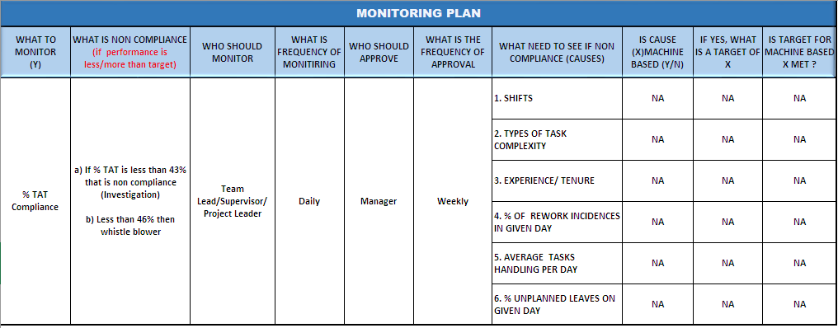
Monitoring Plan
Proprietary and Highly Confidential. 2019 Pursullence Global Business Solutions. All Rights Reserved

Slide 62
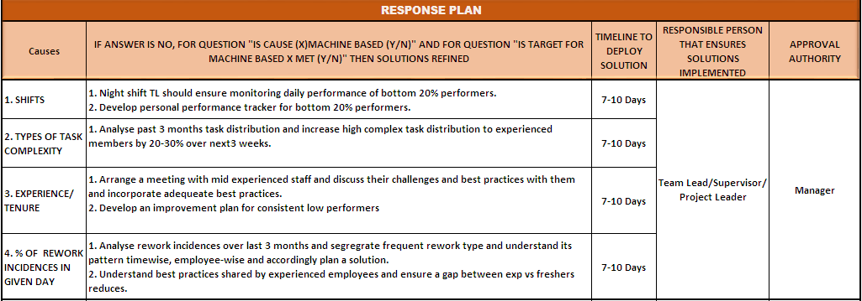
Response Plan
Proprietary and Highly Confidential. 2019 Pursullence Global Business Solutions. All Rights Reserved

Slide 63
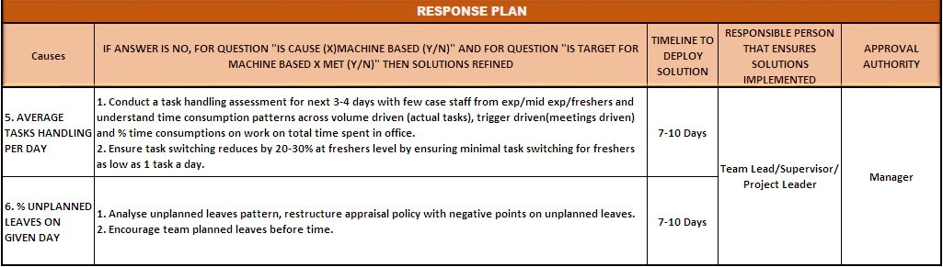
Response Plan (Cont….)
Proprietary and Highly Confidential. 2019 Pursullence Global Business Solutions. All Rights Reserved

Slide 64
Project Sign off & Closure
Receiving approval from Process Owner, MBB and Finance Manager for project completion.
We computed Long term sigma, as short term sigma not applicable here. Every single month for next 3 months it will be responsibility of supervisor to share that data with GB.
The responsibility of GB is to calculate sigma value for every month. GB need to investigate If that value is less than long term sigma and if it is less and If it happens consistently for 3 months then BB need to get involve and fix it.
Submission of LSS GB project master file, cause and solutions log and relevant documents to responsible person from operation.
Proprietary and Highly Confidential. 2019 Pursullence Global Business Solutions. All Rights Reserved

Slide 65
THANK YOU
Proprietary and Highly Confidential. 2019 Pursullence Global Business Solutions. All Rights Reserved

